Slide 1
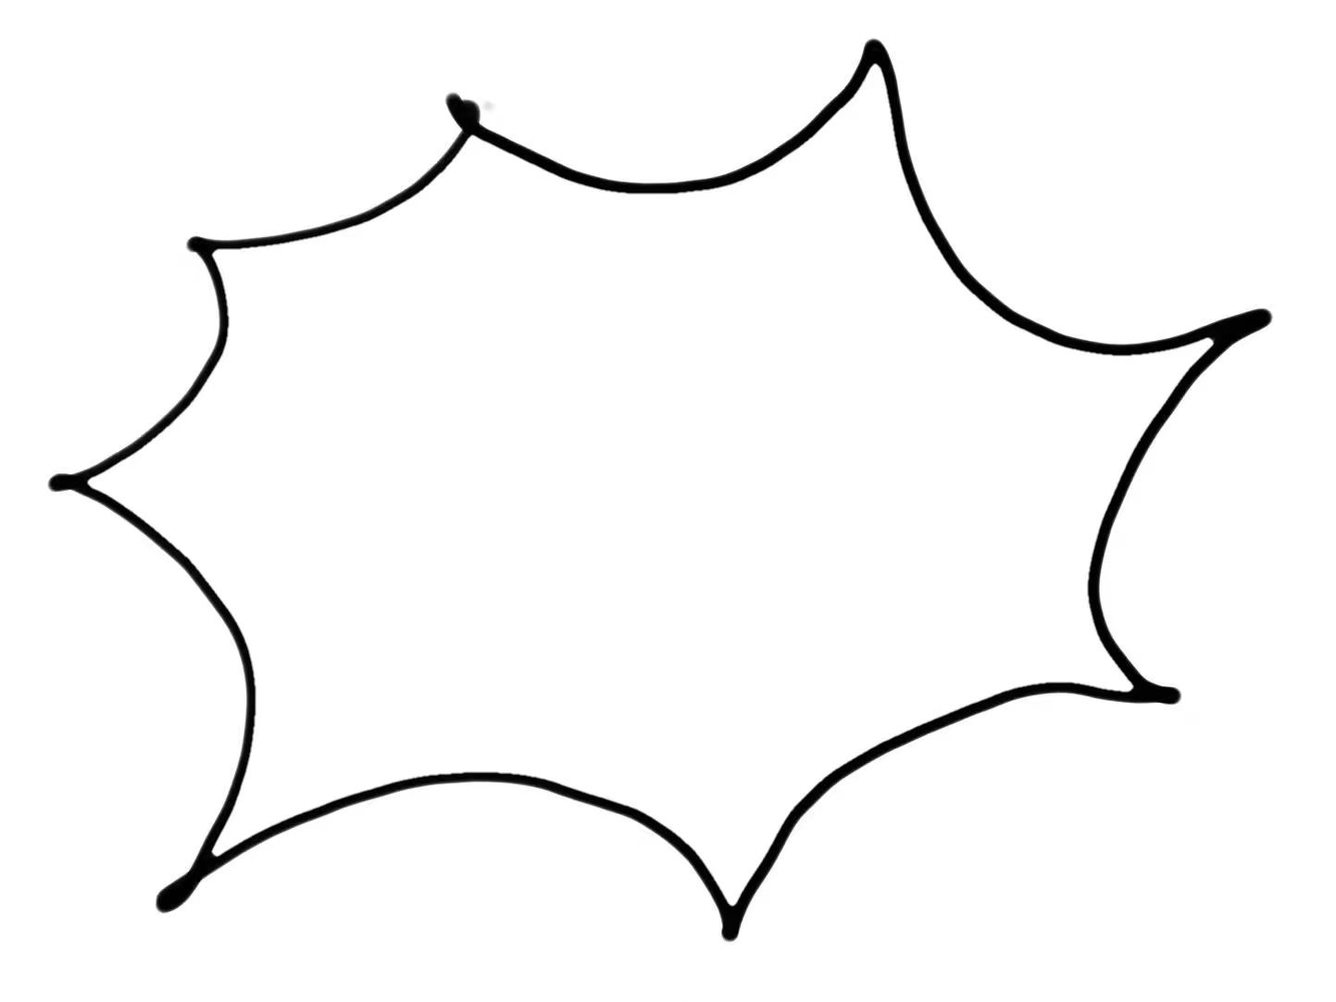
fightingICE competition2024
Developer's Name: ZIFAN YE
Affiliation: Ritsumeikan University

Slide 2

KiraAI
Information
Structure
AI’s name: KiraAI
Developer's Name: ZIFAN YE
Affiliation: Ritsumeikan University
supervised learning based
+DQN model
aims:
to build one ai with strong willing to attack.

Slide 3
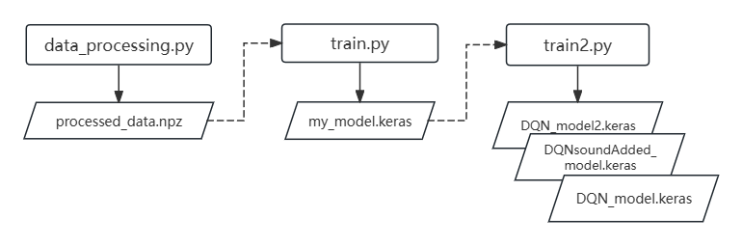
Files

Slide 4
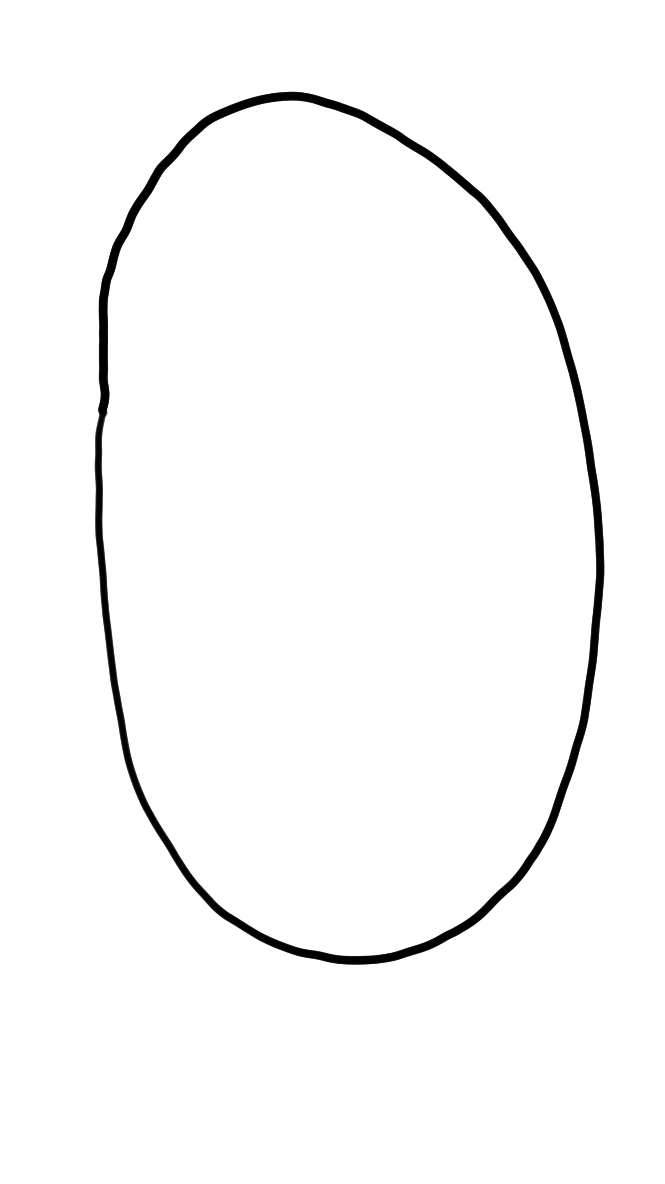
AI’s outline
DQN model:
Pretrained model:
Copy pretrained model's architecture and weights
|-- Add fully connected layers for action space
| |
| |-- Input(shape=input_shape)
| |-- Dense(256, activation='relu')
| |-- Dropout(0.5)
| |-- Dense(128, activation='relu')
| |-- Dropout(0.5)
| |-- Dense(64, activation='relu')
| |-- Dropout(0.5)
| |-- Dense(num_actions, activation='linear')
Define model (Sequential)
| |
| |-- Dense(256, activation='relu')
| |-- Dropout(0.5)
| |-- Dense(128, activation='relu')
| |-- Dropout(0.5)
| |-- Dense(64, activation='relu')
| |-- Dropout(0.5)
| |-- Dense(y_train.shape[1], activation='softmax')

Slide 5
FightingICEEnv(gym.Env)
1.Attack Actions:
Certain actions are predefined as aggressive or attack actions. When the player performs one of these actions, they receive a small reward.
Example attack actions: "THROW_A", "THROW_B", "STAND_A", "STAND_B", "STAND_FA", "STAND_FB", "THROW_HIT", "THROW_SUFFER".
2.Random Enemy Action Selection:
The enemy selects actions randomly from a predefined set of actions. Some actions have a chance to hit the player, causing damage.
3.Reward:
When the player selects an attack action, reward+2.0
When the player wins,reward+50.0 and when it lose then reward-50.0

Slide 6
Result
The pretrained model, using supervised learning, can already respond to the opponent’s actions to some extent.
Therefore, the goal is to enhance the pretrained model by adding more aggressive behaviors.
not very clever() but Aggressive.
“I originally intended to tweak the overall framework, but in the end, it couldn't even beat the previously trained models. So, I just decided to enter the competition as it is.”
--->Watch the fighting video

Slide 7
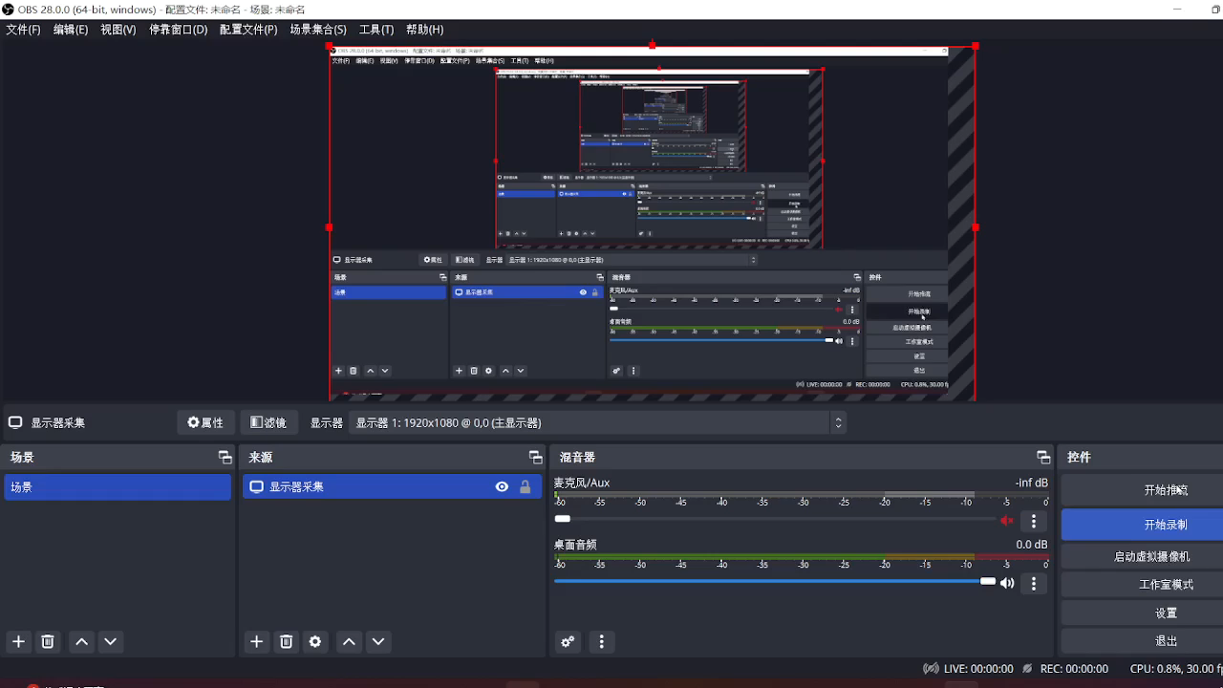
P1:KiraAI P2:testAI
p.s. the Sequential.call error is in testAI which let P2 to action in “STAND_D_DF_FA“, you can ignore this,which made the P2 stronger?

Slide 8
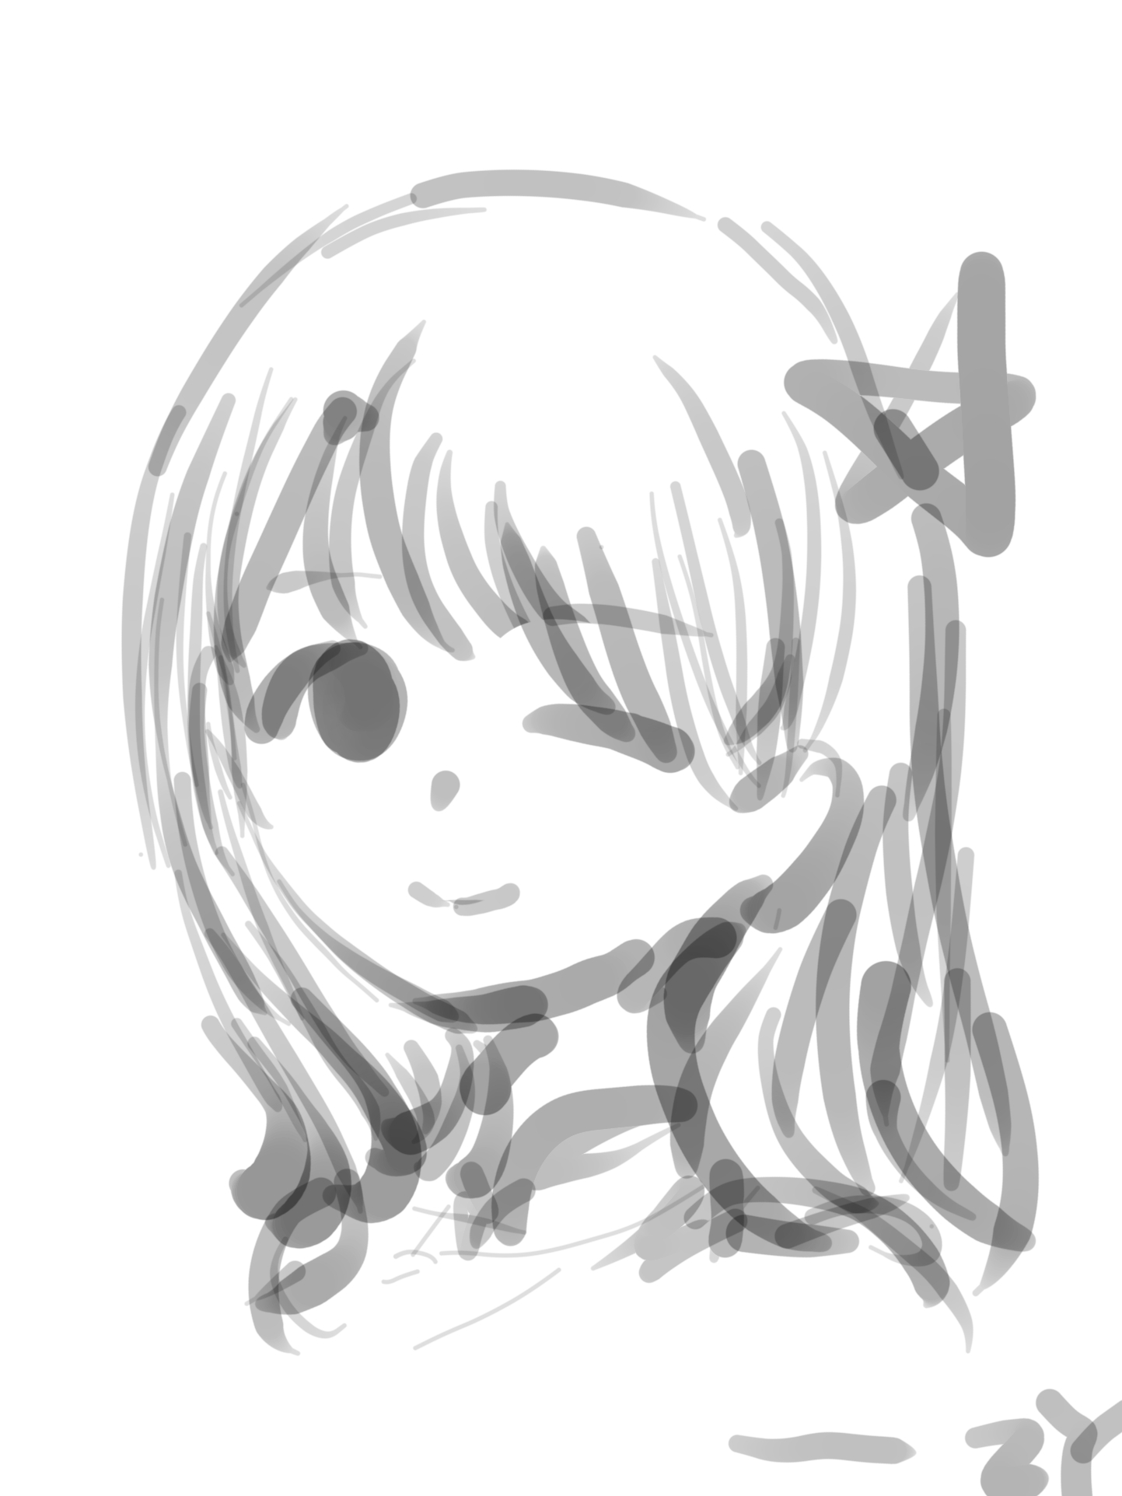
Thanks for watching!!

